Slide 1

DNA-seq alignments and genome analysis Quantitative Methods Workshop 2026
Erik Owen
January 5, 2026

Slide 2
Welcome to today’s genomics roadmap:
Sequencing technology: how reads (and errors!) are made
Covered in prework section
File formats: FASTA, FASTQ, SAM, BAM, VCF
Align reads to reference genome
Call variants + interpret evidence
Understand depth & coverage
Case studies:
Pathogenic SNP in HBB locus
Repeat-heavy complexity in MTERF3 locus

Slide 3
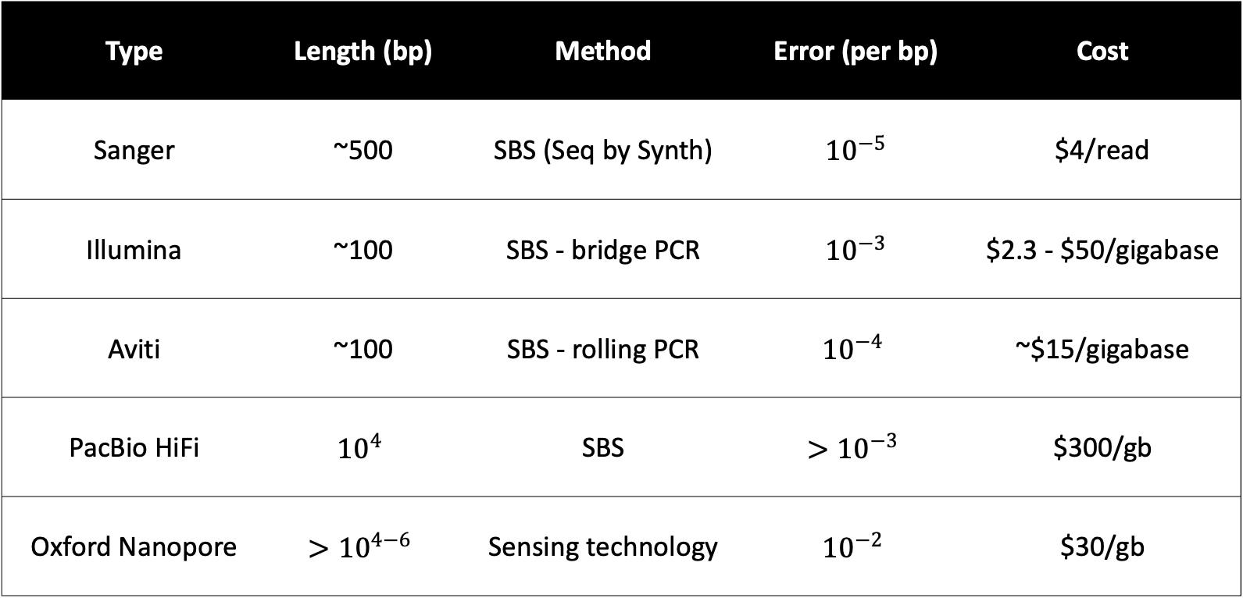
Sequencing Technologies 2026 Overview
Type | Length (bp) | Method | Error (per bp) | Cost
Sanger | ~500 | SBS (Seq by Synth) | ${10}^{−5}$ | $4/read
Illumina | ~100 | SBS - bridge PCR | ${10}^{−3}$ | $2.3 - $50/gigabase
Aviti | ~100 | SBS - rolling PCR | $${10}^{−4}$$ | ~$15/gigabase
PacBio HiFi | $${10}^{4}$$ | SBS | $${>10}^{−3}$$ | $300/gb
Oxford Nanopore | $$>{10}^{4−6}$$ | Sensing technology | $${10}^{−2}$$ | $30/gb

Slide 4
Sequencing Technologies 2026 Overview
Type | Length (bp) | Method | Error (per bp) | Cost
Sanger | ~500 | SBS (Seq by Synth) | ${10}^{−5}$ | $4/read
Illumina | ~100 | SBS - bridge PCR | ${10}^{−3}$ | $2.3 - $50/gigabase
Aviti | ~100 | SBS - rolling PCR | $${10}^{−4}$$ | ~$15/gigabase
PacBio HiFi | $${10}^{4}$$ | SBS | $${>10}^{−3}$$ | $300/gb
Oxford Nanopore | $$>{10}^{4−6}$$ | Sensing technology | $${10}^{−2}$$ | $30/gb
Today’s focus!

Slide 5
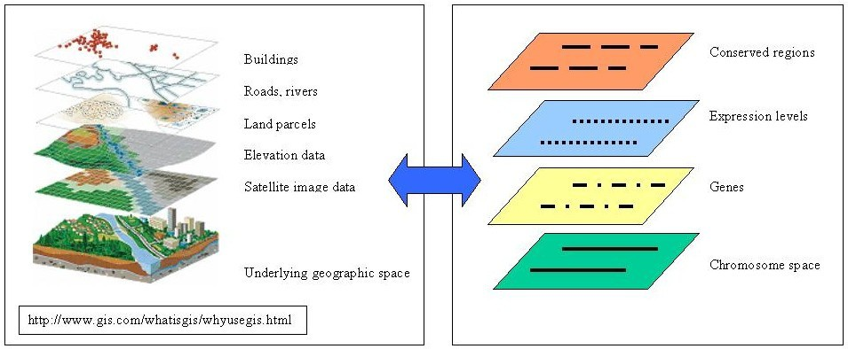
Reference genomes are like maps: Features on either map are coordinate based
Note: Even maps have editions! Better sequencing/assemblers -> new genome “builds”
Dolan, Mary E et al. “Genomes as geography: using GIS technology to build interactive genome feature maps.” BMC bioinformatics vol. 7 416. 19 Sep. 2006, doi:10.1186/1471-2105-7-416

Slide 6
Genomic coordinates require a build
A coordinate is like a street address:
MIT
77 Massachusetts Ave.
Cambridge, MA 02139
Genome coordinates need:
A build: {hg19, hg38, hs1}
A chromosome:
Position range:
For variants, what change?
Here’s a range describing the locus for XIST:
hg38 chrX:73,820,656-73,852,714
Here’s a variant example:
hg38 chr1:55,555,555 G>A
Note: for position range, 0-based vs. 1-based matters based on file type (more later)
Notes:
Note on the position range > 0-based vs. 1-based depending on what file type

Slide 7
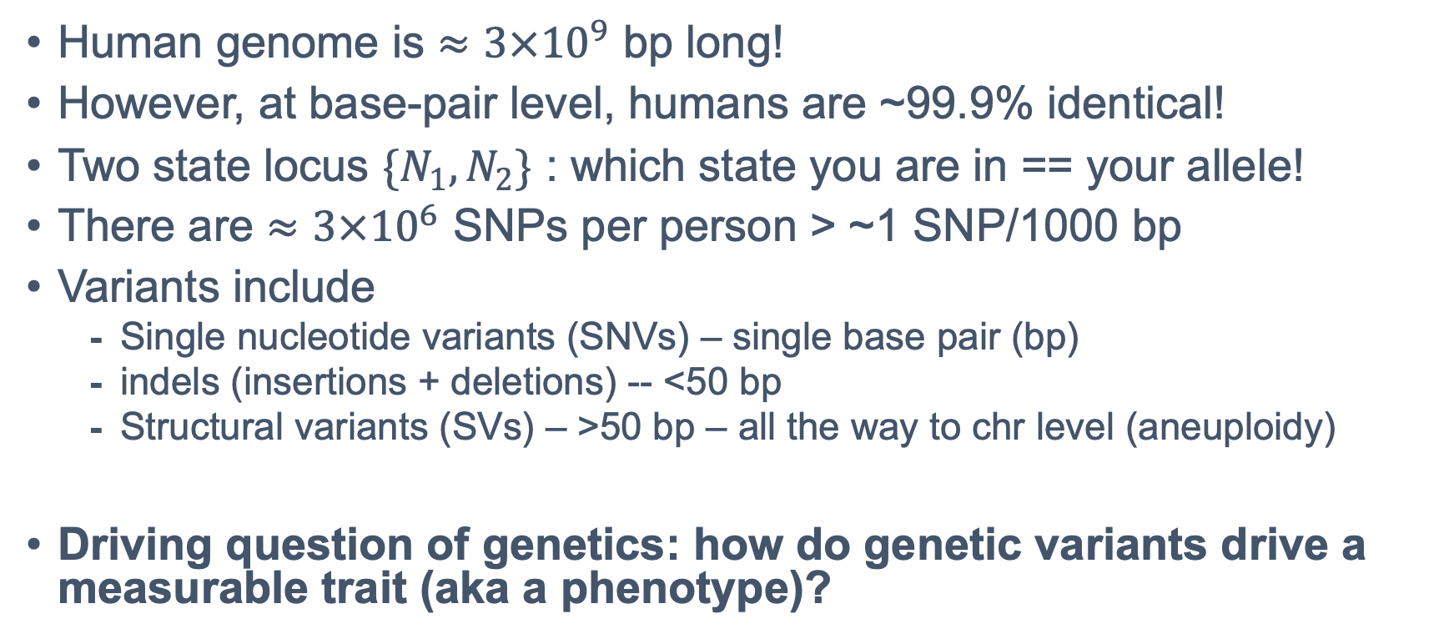
No two people are 100% identical; we carry germline & somatic mutations
Human genome is $≈3×{10}^{9}$ bp long!
However, at base-pair level, humans are ~99.9% identical!
Two state locus $\{N_{1}, N_{2}\}$ : which state you are in == your allele!
There are $≈3×{10}^{6}$ SNPs per person > ~1 SNP/1000 bp
Variants include
Single nucleotide variants (SNVs) – single base pair (bp)
indels (insertions + deletions) -- <50 bp
Structural variants (SVs) – >50 bp – all the way to chr level (aneuploidy)
Driving question of genetics: how do genetic variants drive a measurable trait (aka a phenotype)?
Notes:
Single nucleotide polymorphisms (SNPs) are single nucleotide variants (SNVs) with >1% minor allele frequency (MAF)
minor allele frequency := % of population that has non-reference allele

Slide 8
A variant call is an evidenced-based claim
Variant := difference from reference
Variant call := interpretation of evidence
Interpretation labels:
Benign
Likely Benign
Variant of Uncertain Significance (VUS)
Likely Pathogenic
Pathogenic
Today’s goal: learn how to find a variant!

Slide 9
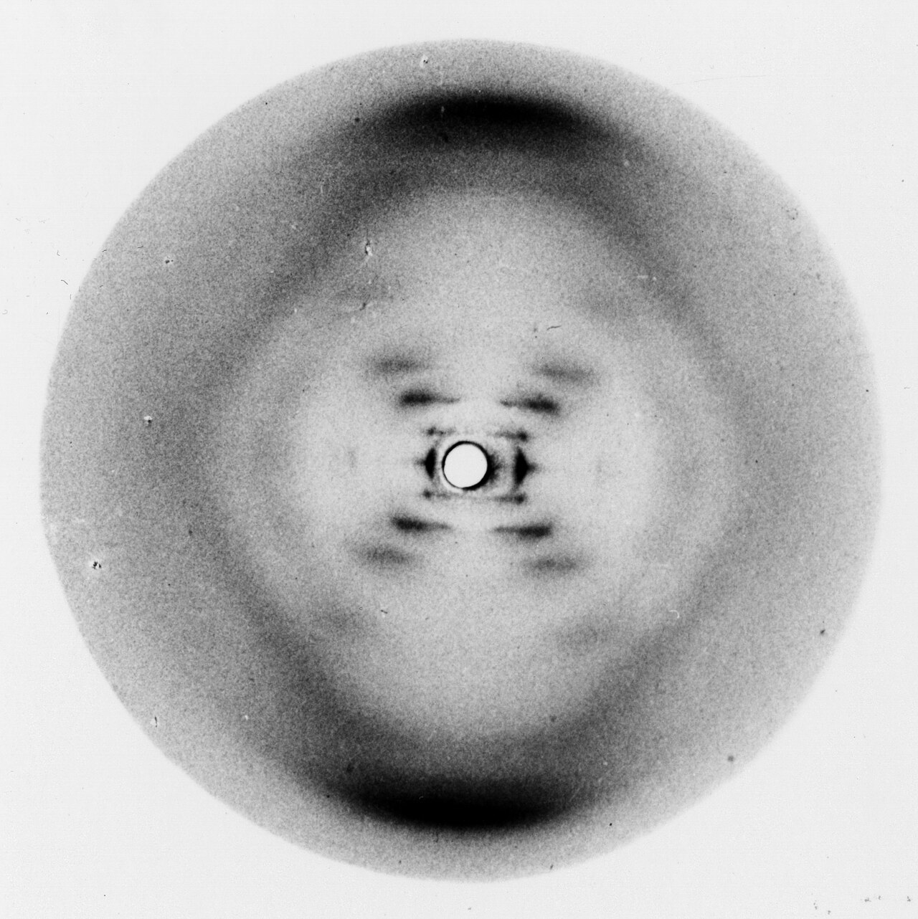
Checkpoint! Answer questions in LMS
Photo 51, Raymond Gosling and Rosalind Franklin 1952

Slide 10
Case studies: same pipeline, different trust
Locus 1: HBB (on chr11)
Locus 2: MTERF3 (on chr8)
HBB codes for Hemoglobin subunit beta
Has functional evidence for how a SNV causes sickle cell disease
MTERF3 codes for Mitochondrial Transcription Termination Factor 3
Repeat-heavy region which will let us study ambiguous alignments **if we have time**
Pipeline output:
FASTQ
BAM
VCF
IGV
Notes:
Do twice: one locus where the answer is clean, and one locus designed to trick us.
Your job is not to get a VCF (variant call format file) bc software always gives you a VCF. Your job is to decide what you trust, and defend it using evidence.

Slide 11
Using notebook with colab, you will generate:
1
QC summary from FASTQ
2
Alignment (BAM) & index
3
Coverage & MAPQ summaries
4
Variant calls (VCF)
5
Visualization of variants

Slide 12

Before you trust a call, check:
Base quality (Q)
Mapping Quality (MAPQ)
Depth / allele fraction
Repeat Context

Slide 13

Now follow instructions in the README of the linked git repo for Environment Setup
https://github.com/erik-owen/2026_QMW_Genomics/tree/main

Slide 14
Complete the Sequencing & File formats portion in colab
https://github.com/erik-owen/2026_QMW_Genomics/tree/main

Slide 15
Alignment Module
Aligners
algorithms that place each read on a reference by optimizing a score
matches == good
mismatches, indels, clipping == bad
Repeats create multiple equally good placements
Leads to “multi-mapping” where aligner can’t be confident
MAPQ metric
Confidence in placement of (trimmed) read
Low MAPQ == “this read could be put in multiple places in the reference”

Slide 16

Aligner walkthrough demo: Bowtie2
Bowtie2 is a short-read alignment tool
Good at aligning reads of 50-100s/1000s of characters
https://bowtie-bio.sourceforge.net/bowtie2/index.shtml
If you would like to learn how the genome indexing works “under the hood”, it’s based on the Burrows-Wheeler transform

Slide 17
End-to-end vs local alignment
End-to-End involves all characters in read
Local alignment allows trimming/clipping
Alignment:
Read: GACTGGGCGATCTCGACTTCG
||||| |||||||||| |||
GACTG--CGATCTCGACATCG
Reference:
Alignment:
Read: ACGGTTGCGTTAA-TCCGCCACG
||||||||| ||||||
TAACTTGCGTTAAATCCGCCTGG
Reference:
https://bowtie-bio.sourceforge.net/bowtie2/manual.shtml#end-to-end-alignment-versus-local-alignment

Slide 18
Now let’s work through the Alignment portion of the notebook
https://github.com/erik-owen/2026_QMW_Genomics/tree/main

Slide 19
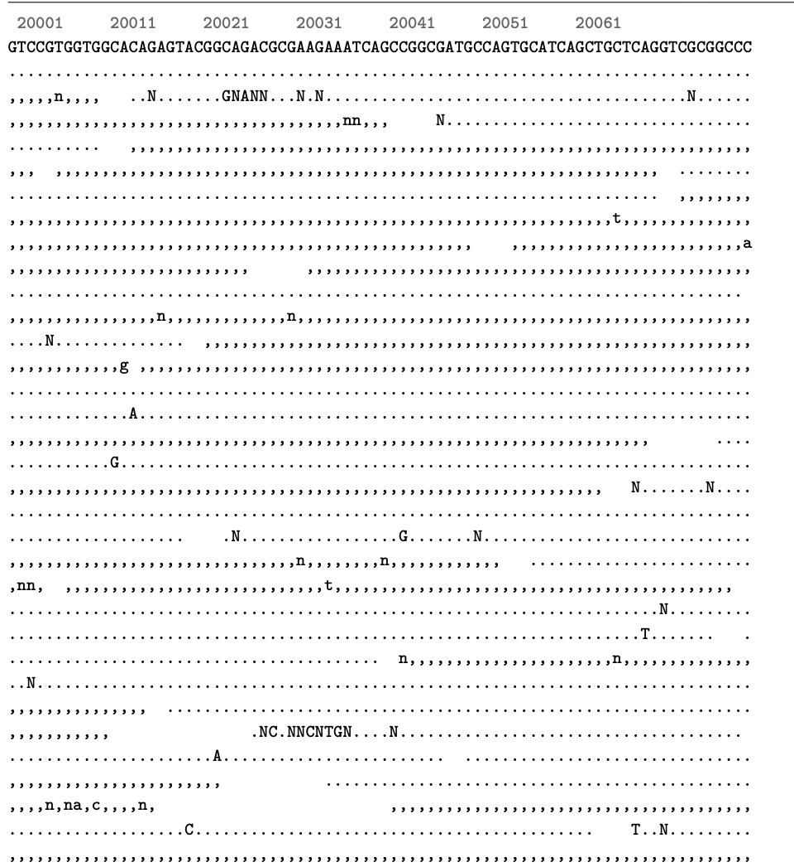
Pileups, Variants, & Interpretation
Pileup our reads!
Our coverage graph showed we have alignment to our reference FASTA
Now we want to look to find if we have variants in the individual we sequenced from relative to our reference

Slide 20
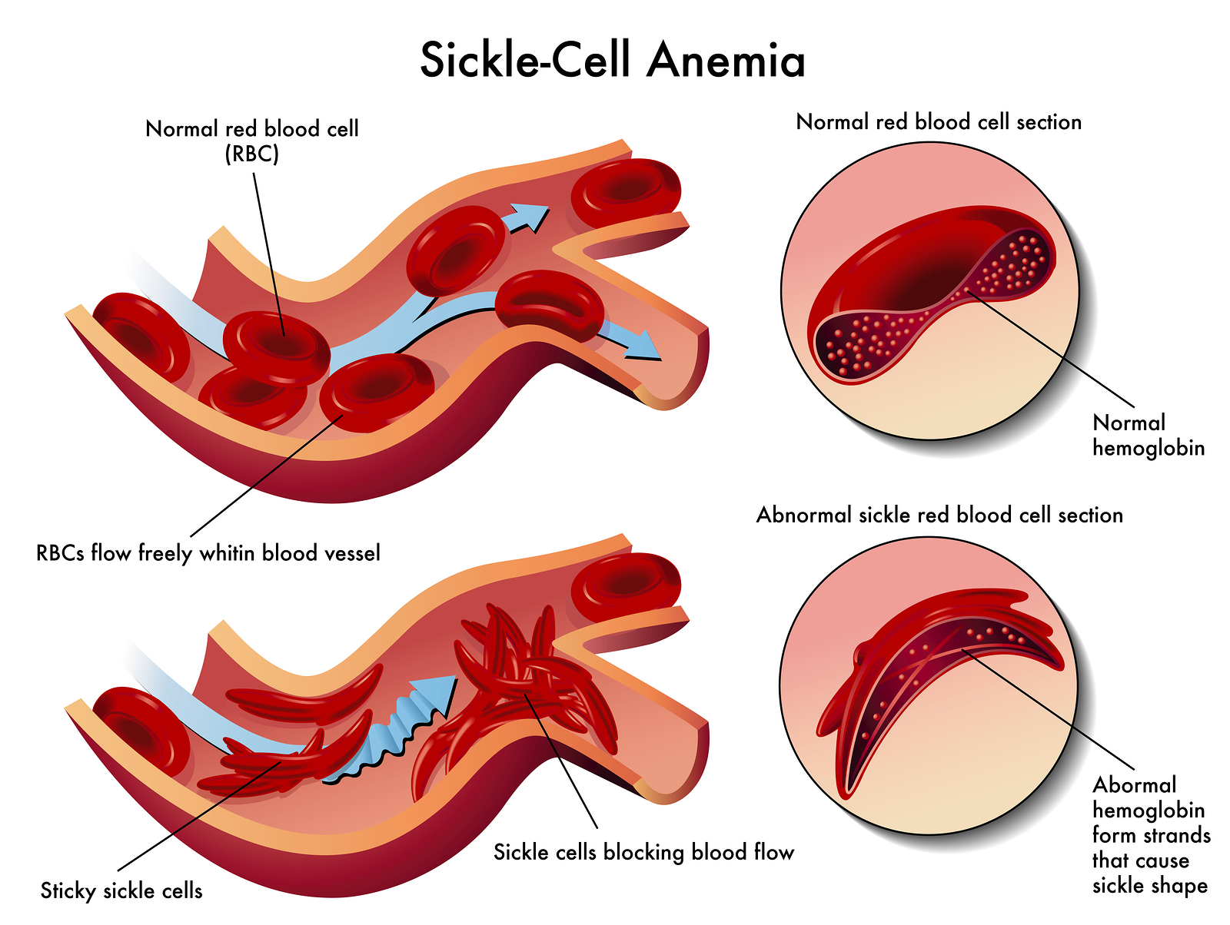
Case Study

Slide 21
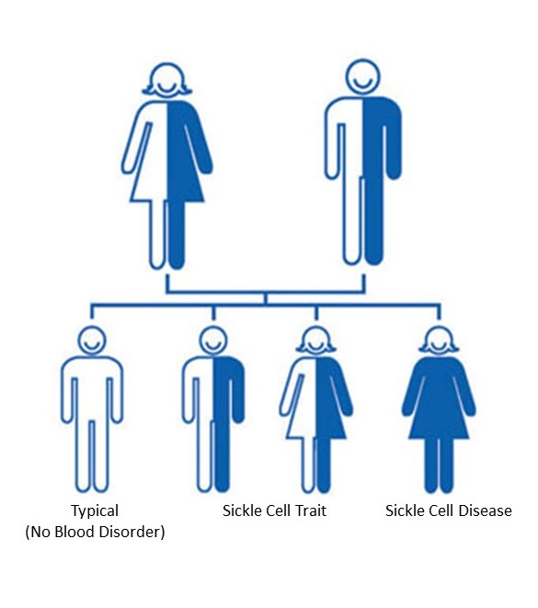
Sickle Cell Disease appears as an autosomal recessive pattern
Sickle Cell Trait can sometimes also lead to pain crises
Sickle cell disease affects ~7.7 million people worldwide
Causes >34k annual deaths; contributes to >375k deaths
However, sickling is protective against malaria, so there’s a “heterozygote advantage”
https://doi.org/10.1016%2FS2352-3026%2823%2900118-7
https://www.cdc.gov/sickle-cell/sickle-cell-trait/index.html

Slide 22
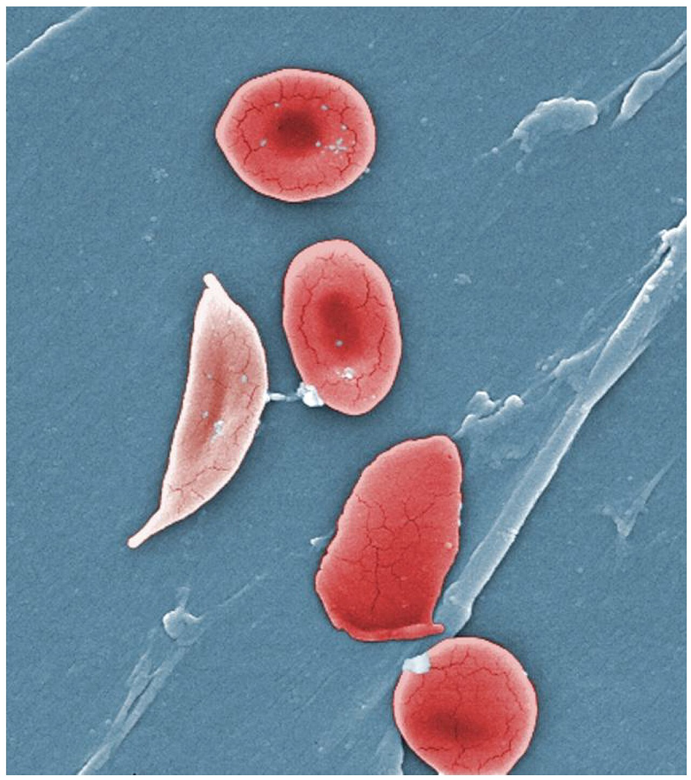
Case study: Sickle Cell Disease
Patient 1: healthy control
Patient 2: from disease cohort trio
No sickle cell
Patient is healthy
However, daughter carries sickle cell disease
We want to know if patient parent is a carrier of a variant that would cause the sickle cell phenotype?

Slide 23
Complete the Pileups & Variant Calling portion in colab
https://github.com/erik-owen/2026_QMW_Genomics/tree/main

Slide 24
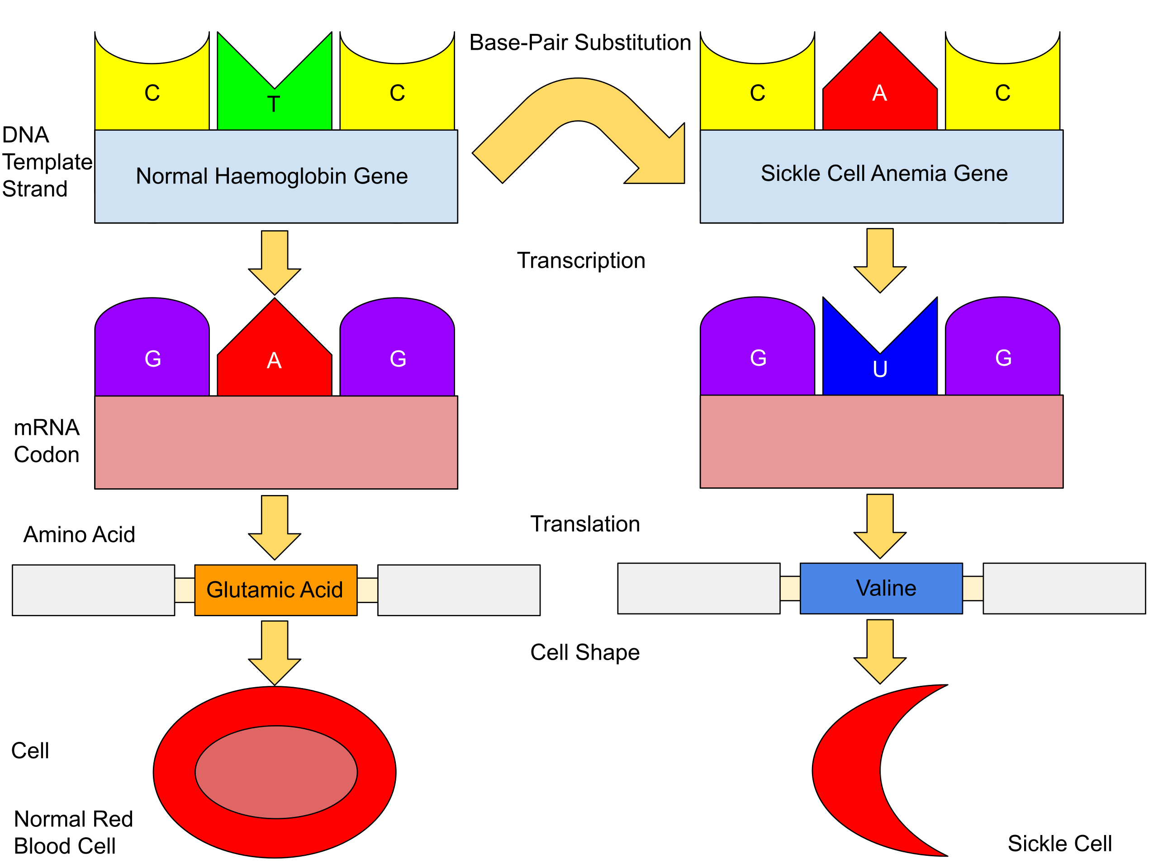
Functional impact of HbS mutation
https://en.wikipedia.org/wiki/Sickle_cell_disease#/media/File:Sickle_Cell_Anemia.svg

Slide 25
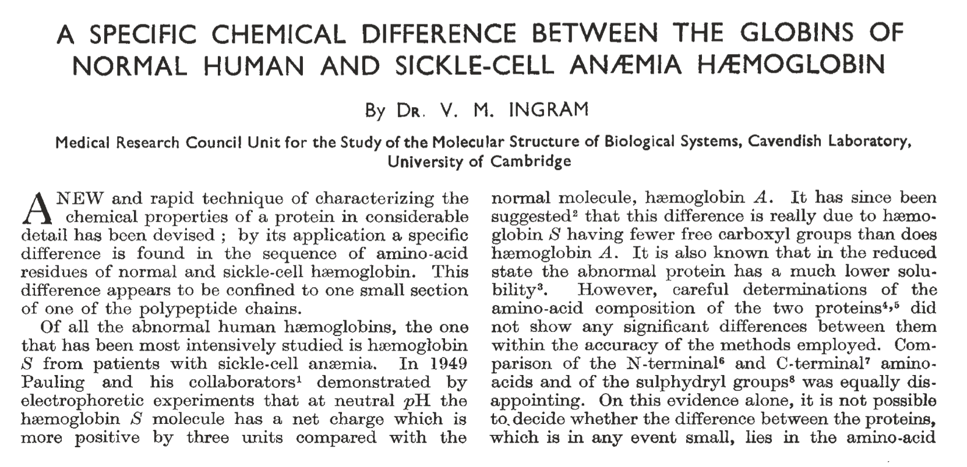
Molecular change in HbS was described in 1956 – before sequencing!
INGRAM, V. A Specific Chemical Difference Between the Globins of Normal Human and Sickle-Cell Anæmia Hæmoglobin. Nature 178, 792–794 (1956). https://doi.org/10.1038/178792a0

Slide 26
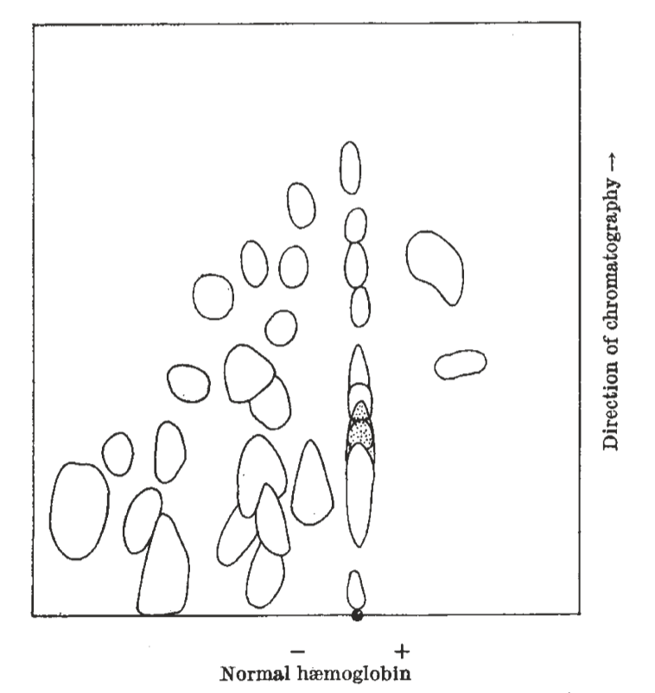
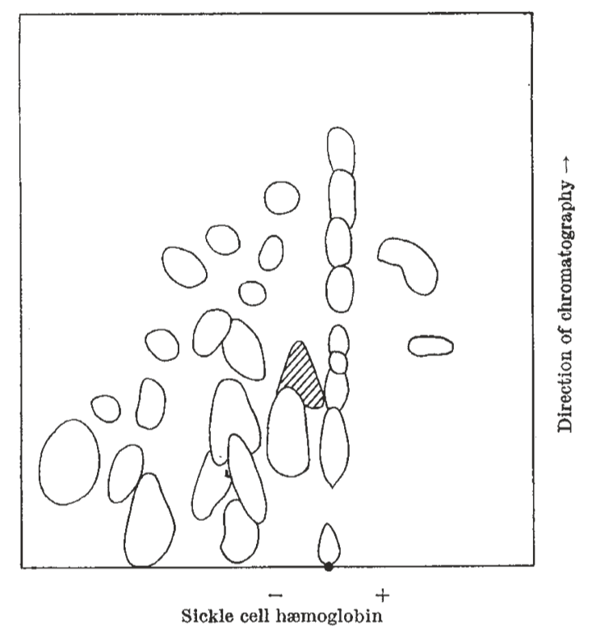
Molecular change in HbS was described in 1956 – before sequencing!
INGRAM, V. A Specific Chemical Difference Between the Globins of Normal Human and Sickle-Cell Anæmia Hæmoglobin. Nature 178, 792–794 (1956). https://doi.org/10.1038/178792a0

Slide 27
What is the future of sickle cell disease management?
Slides adapted from HMS case conference by Maya Talukdar, PhD

Slide 28
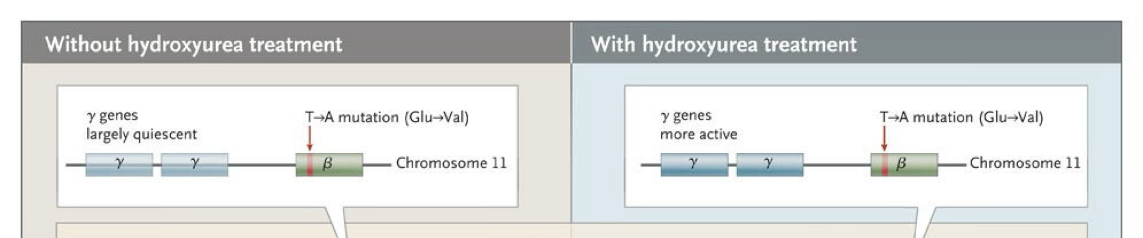
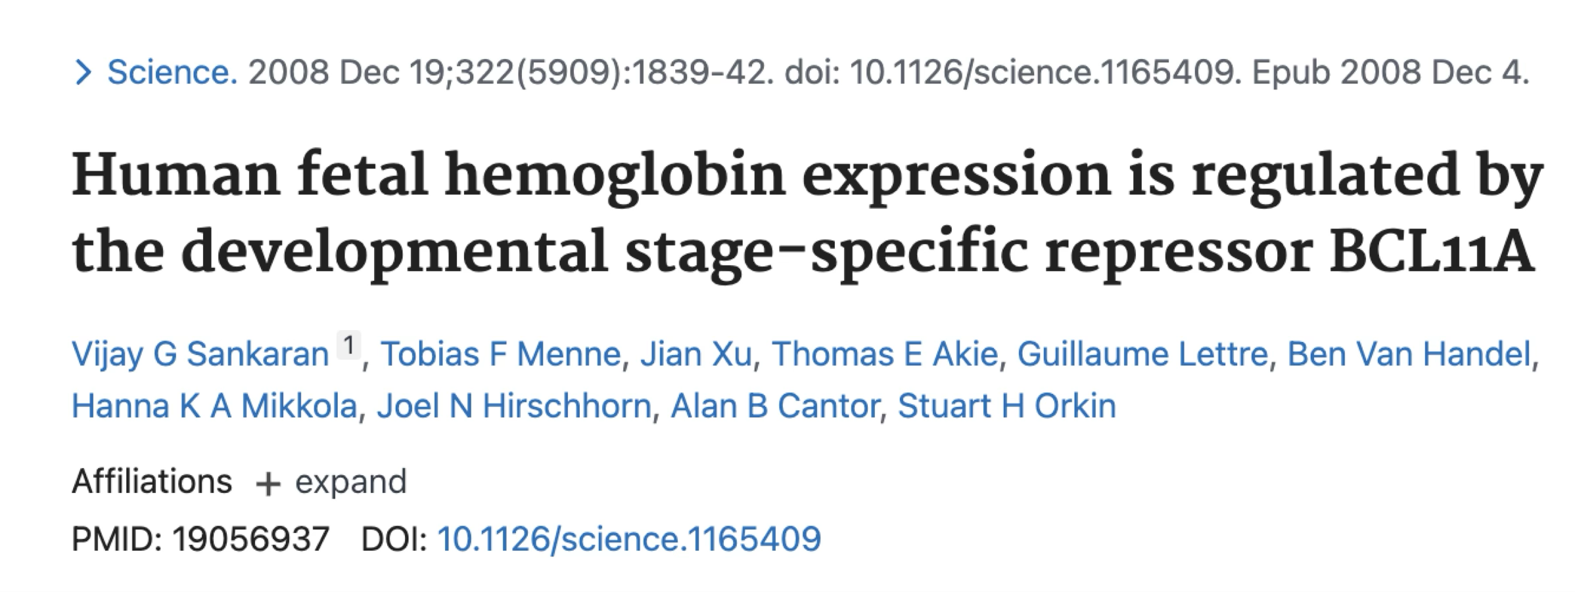
What is the future of sickle cell disease management?
What genetic variants do people who naturally have very high levels of HbF carry?

Slide 29
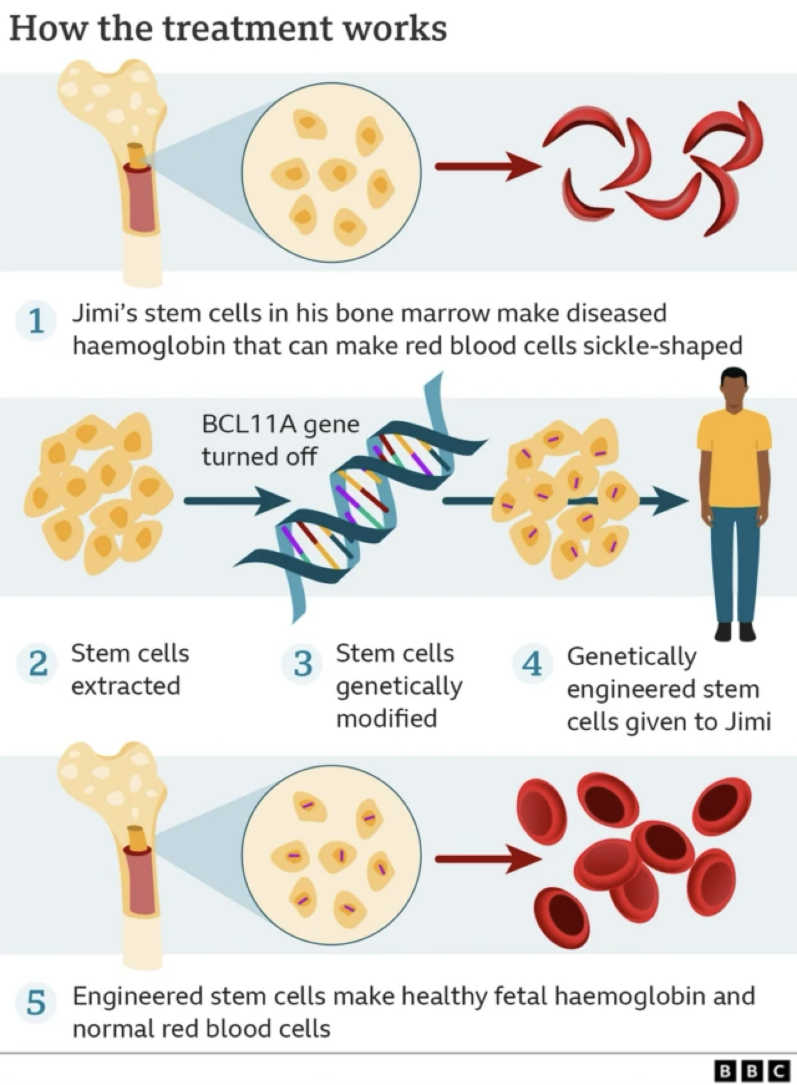
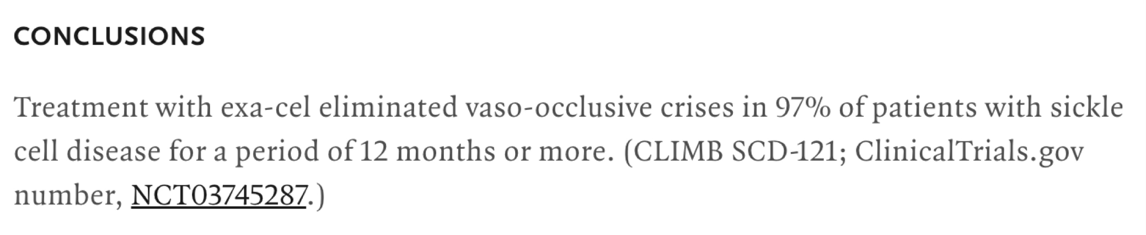
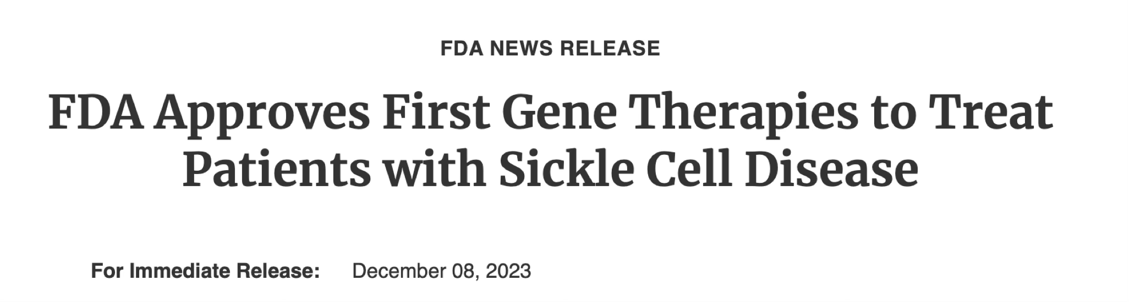
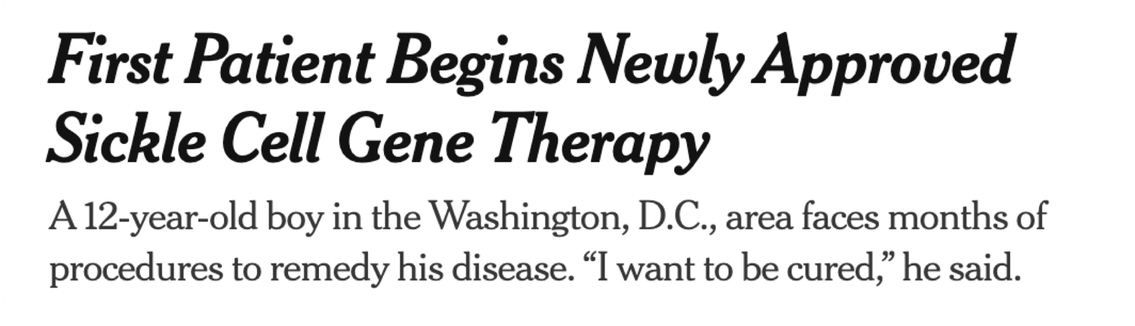
What is the future of sickle cell disease management?

Slide 30
Wrapup: Before you trust a call, check:
Base quality (Q)
Mapping Quality (MAPQ)
Depth / allele fraction
Repeat Context

Slide 31
What’s next?
Long read sequencing and aligners like minimap2
STAR for RNA-seq
Structural variants
Assemblers
Variant interpretation: ClinVar https://www.clinicalgenome.org/data-sharing/clinvar/

Slide 32
Thank you!! Hope you’re excited about genomics!!!
Special Acknowledgements:
Mentorship in the Page Lab
Especially D.W. Bellott and H. Skaletsky
HST.508 Population and Quantitative Genomics
Professors Tami Liberman and Leonid Mirny
Feel free to chat after class or email about:
genomics & bioethics
industry vs. academia
grad school
email: eowen (at) mit (dot) edu

